Slide 1
Costly Misclassification
What we can do to fix it!

Slide 2
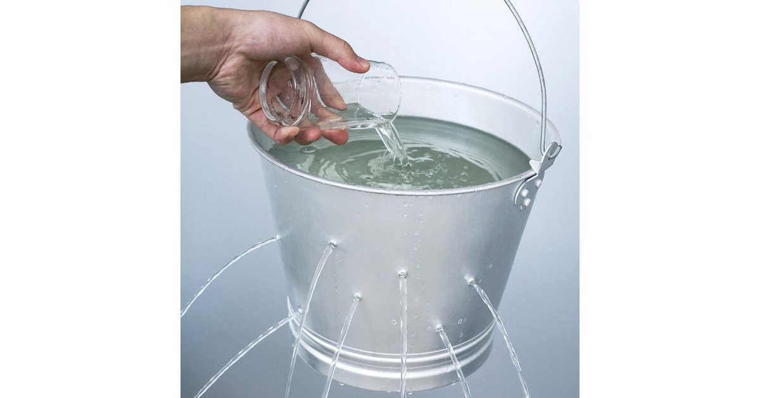
Where Do The Costs Accrue?
We’re spending money we don’t need to be!
Misdiagnosing a patient can sometimes prove to be very costly. We can avoid some of these costs by allowing the model to 'abstain' from making a prediction, whenever it is uncertain about the diagnosis for a patient.
If the hospital abstains, it will have to send the patient to an endocrinologist, which would incur additional cost, but not as much as a misclassification!
It pays not to be wrong!

Slide 3
How Do we Fix the System?
We need to find the right situations to diagnose patients and when to abstain from making a diagnosis
We need to make decisions based on probability of a disease given the data we have.
We need to find the threshold probability where we can minimize the cost per patient.
In summary, we need to find the optimal level of certainty we need to diagnose a patient

Slide 4

How Do We Find Our Threshold?
Skipping the boring details, we train a model based on all of our previous thyroid diagnosis data and how it related to thyroid-stimulating hormones
We can then test our model with the entire range of thresholds to find which one minimizes cost.

Slide 5
The Results…
Using the previously explained process, we were able to create a model that uses an ‘abstain’ option.
And it was good…
Before using our model, the hospital spent $796.46 dollars per patient
With the model, we lower the cost by over $100 per patient to only $687.17 per patient

